Slide 1

MOBILE DATA VISUALIZATION USING PowerBI
Analyzing Mobile Brands, Technical Specs, and Prices Across Countries NAME-NARESH KUMAR MANICKAM

Slide 2

DATASET OVERVIEW
Dataset Source: Kaggle Mobile Dataset(https://www.kaggle.com/datasets/abdulmalik1518/mobiles-dataset-2025/data)
Total Records: 930 Mobile Models
Total Brands: 18 Companies
Fields: Company, Model, RAM, Battery, Weight, Camera Specs, Prices (USA, India, Dubai, China), Launch Year
Goal: Analyze model launches, compare technical specs, and pricing across countries.

Slide 3
PLAN OF ACTION
STEPS | TASK
1 | Data Cleaning (fix units, wrong prices, RAM errors)
2 | Exploratory Data Analysis (EDA)
3 | Build Interactive Dashboard in Power BI
4 | Extract Business Insights

Slide 4
DATA CLEANING(EDA)
Removed units (like GB, mAh, inches) to convert to numbers.
Fixed wrong price entries for Xiaomi and Huawei phones.
Filtered RAM range (2GB to 24GB) to remove unrealistic entries (like 812GB).
Final Cleaned Columns:
Company Name, Model Name, RAM (GB), Battery (mAh), Mobile Weight (g), Screen Size (inches), Prices (USA, India, China, Dubai), Launch Year.

Slide 5
DASHBOARD PAGES
PAGE | FOCUS
1 | Overview (Counts, Pie Chart, KPIs)
2 | Price Analysis (Trends, Company Comparison, Model-wise)
3 | Technical Specifications (RAM, Battery, Weight Analysis)
4 | Country-wise Price Comparison

Slide 6
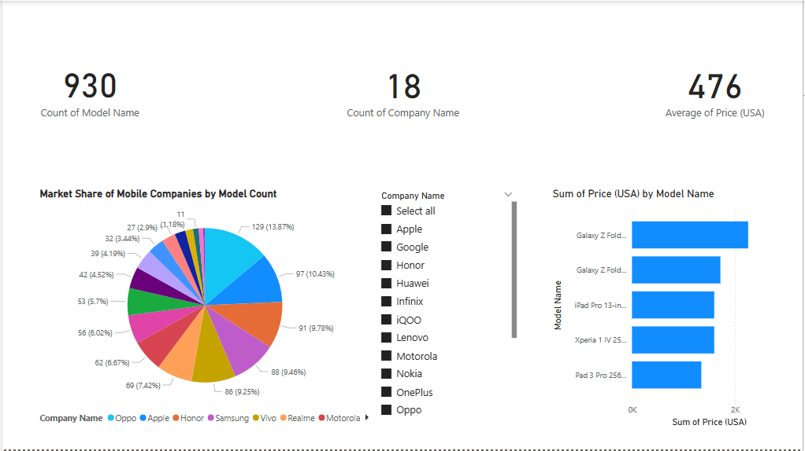
PAGE 1 – OVERVIEW INSIGHTS
930 Models across 18 Brands.
Oppo has highest number of model launches (~14%), followed by Apple and Honor.
Average USA price across all models: $476.
KPI Cards & Pie Charts for quick summary.
Slicer to filter by company dynamically.

Slide 7
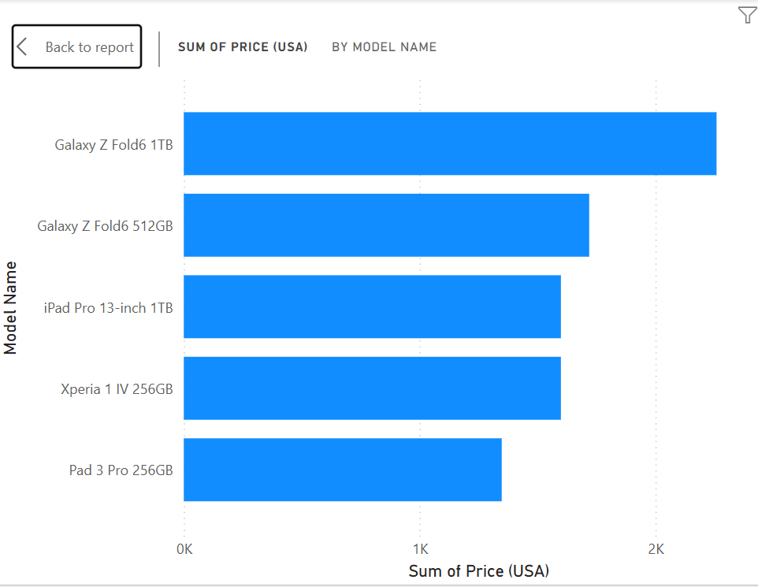
Top 5 Most Expensive Mobile Devices (USA)
Samsung’s Galaxy Z Fold6 (1TB, 512GB) leads the premium segment.
Apple's iPad Pro 13-inch (1TB) ranks among top luxury devices.
Sony Xperia 1 IV and Pad 3 Pro target high-end professional users.
Foldable screens, large storage (256GB–1TB), and flagship features drive prices.

Slide 8
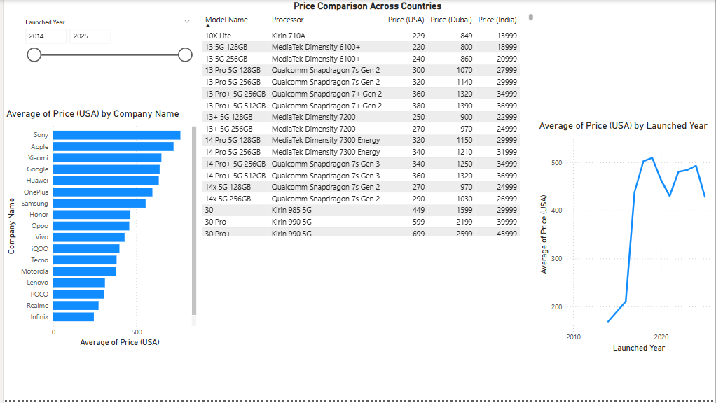
PAGE 2 – PRICE ANALYSIS INSIGHTS
Sony and Apple have the highest average prices in USA.
Price trends show steady growth year-on-year between 2014-2025.
Table: Model Name, Processor, and Prices across 3 countries.
Launched Year slicer for dynamic year-wise analysis.

Slide 9
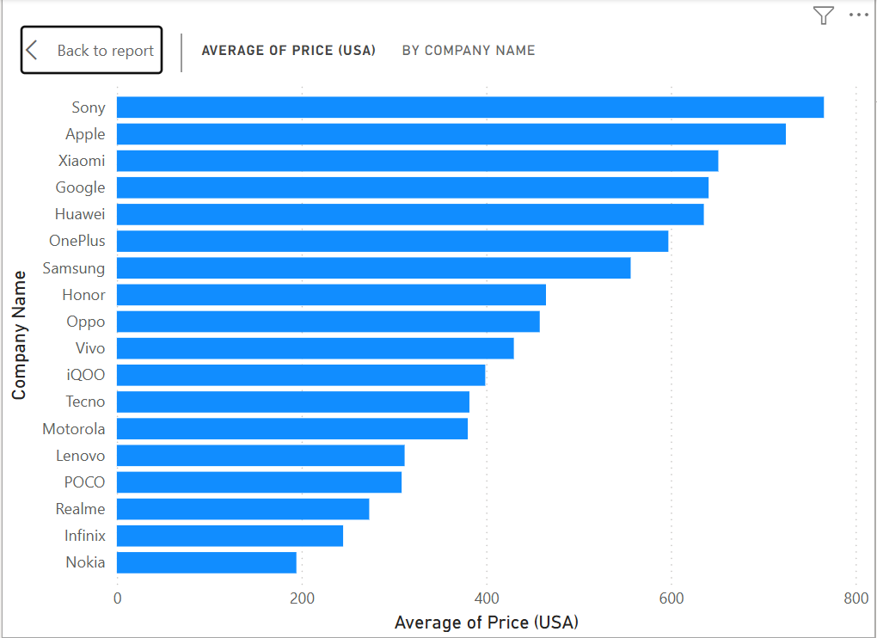
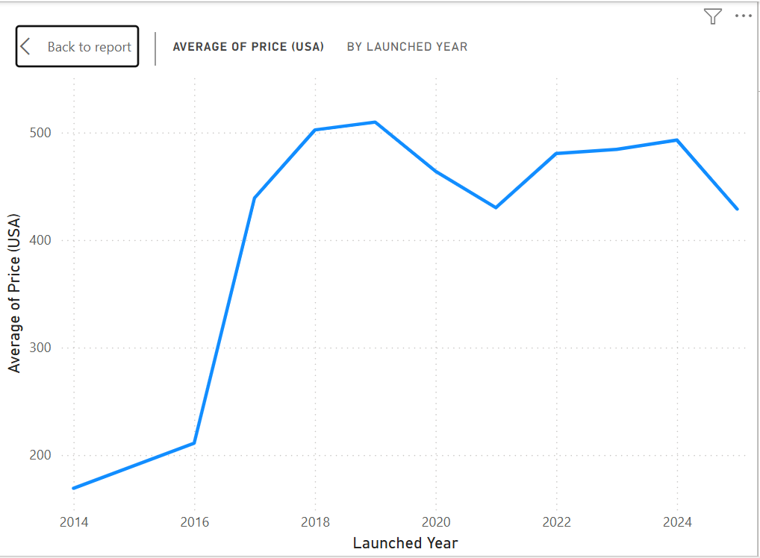
Average Price (USA) by Brand AND YEAR
BRAND
Sony and Apple lead in average price.
Xiaomi, Google, Huawei positioned mid-high.
Samsung covers wide range: budget to premium.
Realme, Infinix, Nokia dominate budget market.
LAUNCHED YEAR
Sharp rise from 2014 to 2017.
Stable around $450–$500 after 2020.
Minor drop in 2025 (future models incomplete).
Reflects smartphone industry maturing post-2020.

Slide 10
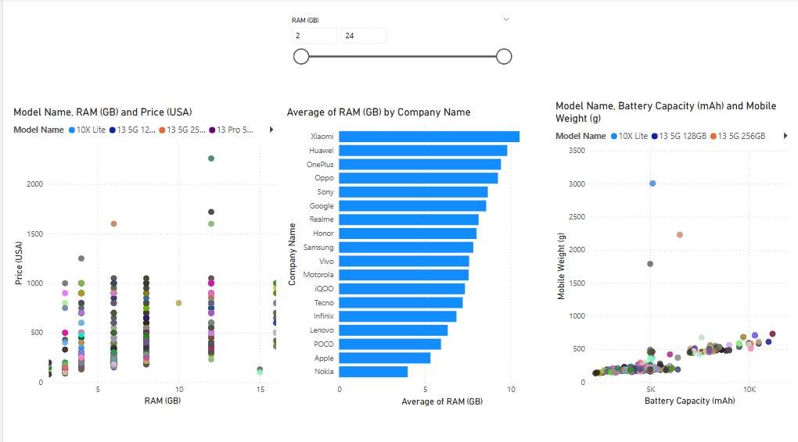
PAGE 3 – TECHNICAL SPECS INSIGHTS
Scatter Plot 1: RAM vs Price — Higher RAM generally increases price.
Scatter Plot 2: Battery Capacity vs Weight — Bigger batteries = heavier phones.
Bar Chart: Xiaomi, Huawei offer highest RAM averages.
RAM Slicer (2-24 GB) applied to ensure clean analysis.

Slide 11
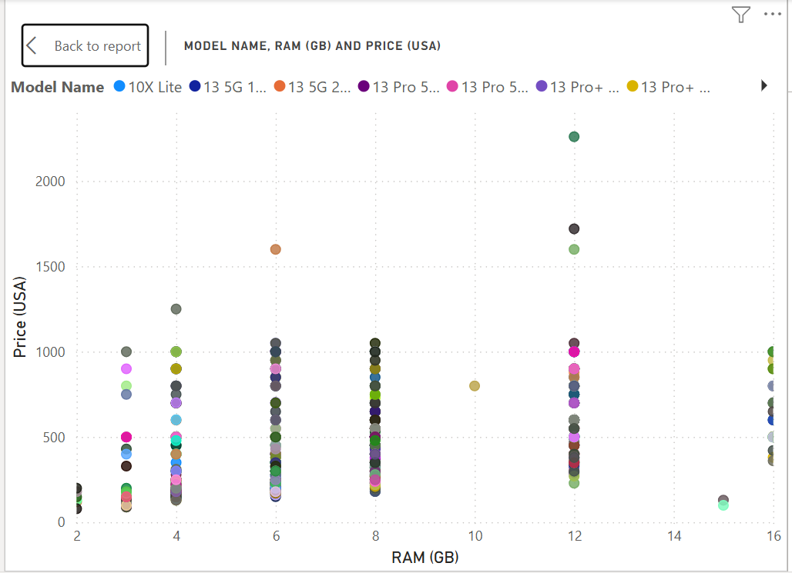
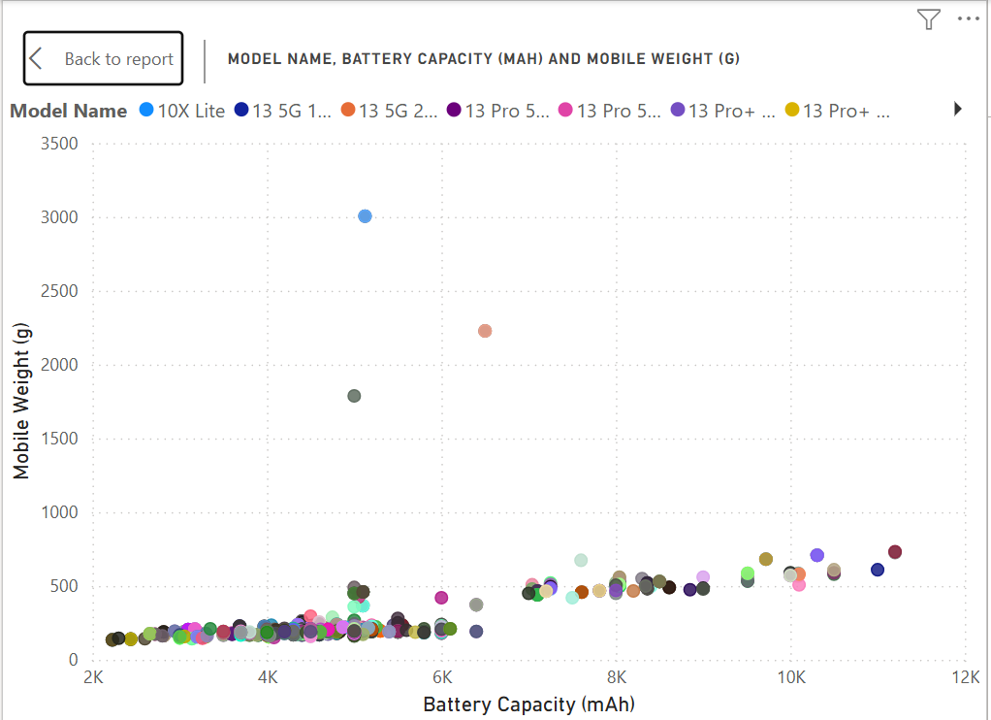
RAM (GB) vs Price (USA)
Higher RAM models generally cost more.
8GB to 12GB phones show wide price spread.
12GB+ models typically $1000+.
Outliers suggest brand, camera, design also impact price.
BATTERY vs WEIGHT INSIGHTS
Higher battery capacity usually increases weight.
Most phones (3000–6000mAh) remain lightweight.
Extreme heavy devices are rare outliers (gaming/rugged phones).

Slide 12
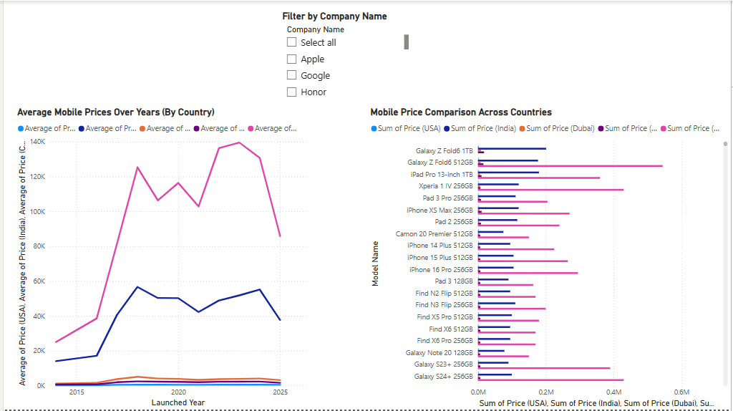
PAGE 4 – COUNTRY PRICE COMPARISON INSIGHTS
USA prices are consistently higher than India, Dubai, China for the same models.
Bar Chart showing model price differences across countries.
iPhones (iPhone 14 Plus, iPhone 16 Pro) and Galaxy Fold dominate high-end segment.
Note: “Price variations reflect local currencies. Pakistan prices appear higher due to recording in PKR without conversion.”

Slide 13
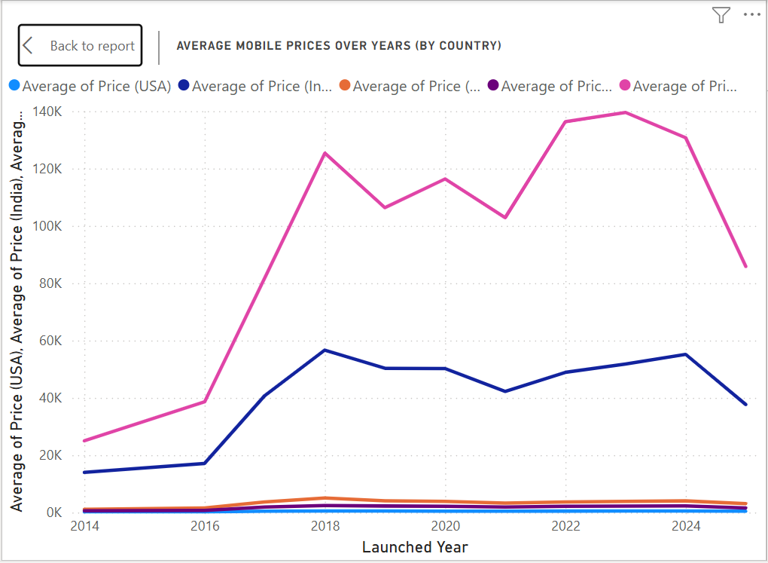
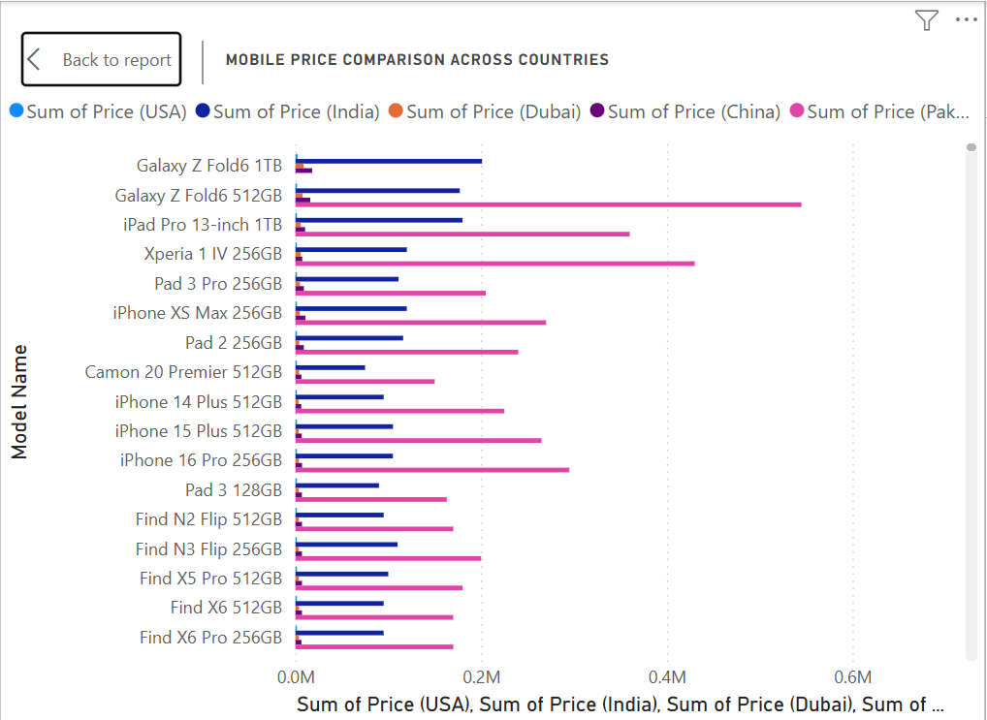
Average Prices by Country Over Years
USA leads in average mobile pricing.
India, China, Pakistan have lower prices.
Dubai shows extreme rise — data anomaly noted.
Overall price growth trend from 2014 to 2025.
Mobile Price Comparison (Country-wise)
Pakistan and USA have highest mobile prices.
Dubai and China offer lower pricing for the same models.
iPhones and Foldables show largest price gaps.
Reflects taxes, market positioning, import costs.

Slide 14
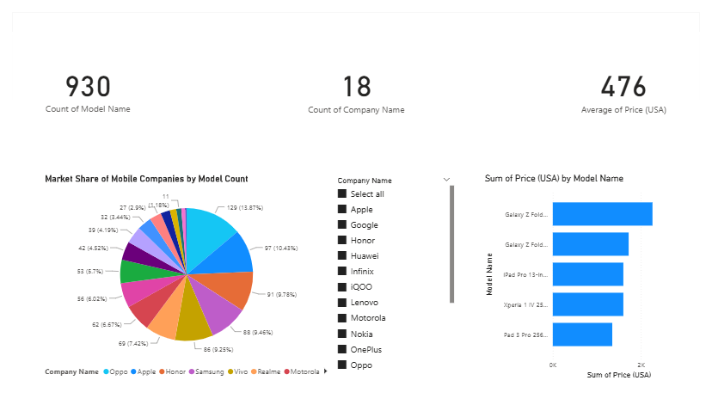
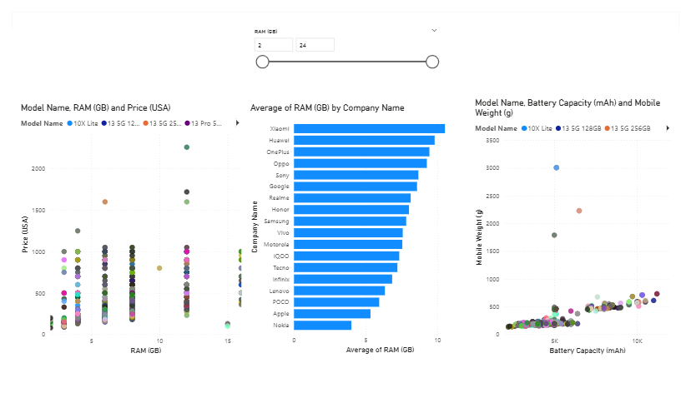
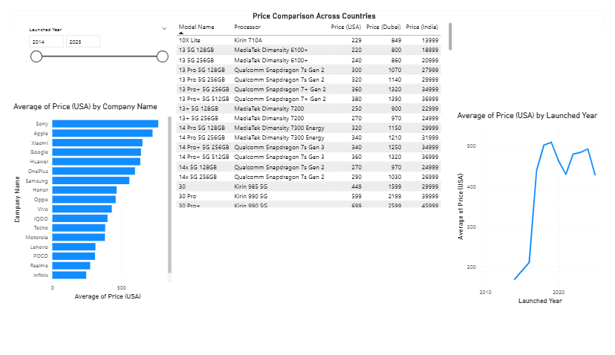
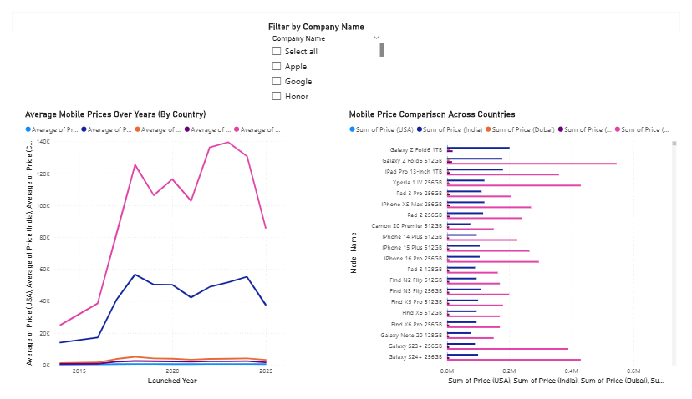

Slide 15

OVERALL CONCLUSION
In this project, I visualized mobile data across companies, specifications, and countries using Power BI. Sony and Apple lead in premium pricing, while Xiaomi and Realme focus on budget segments. Higher RAM and battery capacity generally correlate with higher prices and weight. Mobile prices are highest in USA and Pakistan, but lower in Dubai and China. Overall, this dashboard shows how data visualization reveals market trends, pricing strategies, and product positioning.

